Slide 1
Machine learning workshop
National Central University
FFL lab
Presenter: Cao, Hoang-Tien (高宏天)

Slide 2
Outline
DNN model
Regression problem
Classification problem

Slide 3
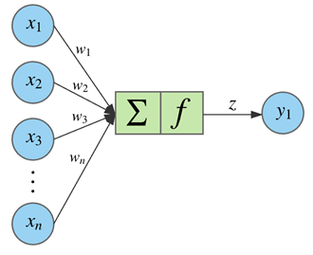
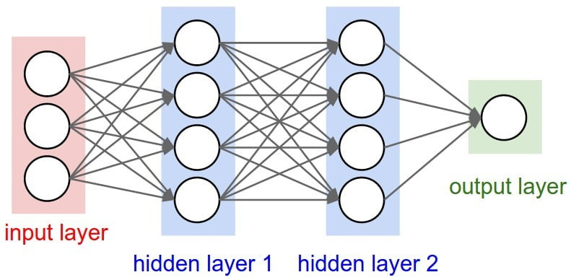
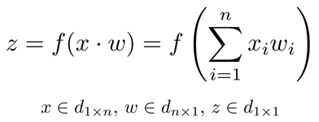
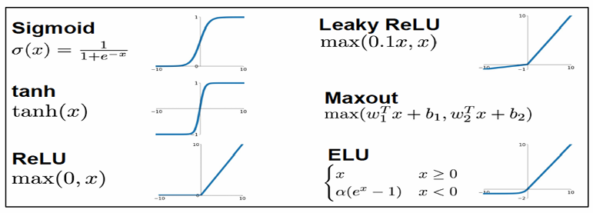
1. DNN model

Slide 4
Note
A node in the neural network is a mathematical function or activation function which maps input to output values.
Inputs represent a set of vector containing weights (w) and bias (b). They are the sets of parameters to be determined for prediction, regression.
Many nodes form a neural layer, links connect layers together, defining a NN model.
Activation function (f or σ ), is generally a nonlinear data operator which facilitates identification of complex features.

Slide 5
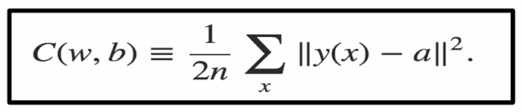
Minimization, Training
Define a cost function C(w,b), the mean squared error (MSE), so the neural network training algorithm finds the weights and biases giving C(w,b)≈0, or minimizes the cost C(w,b) as a function of the weights and biases, casting it as an optimization problem using the gradient descent algorithm.

Slide 6
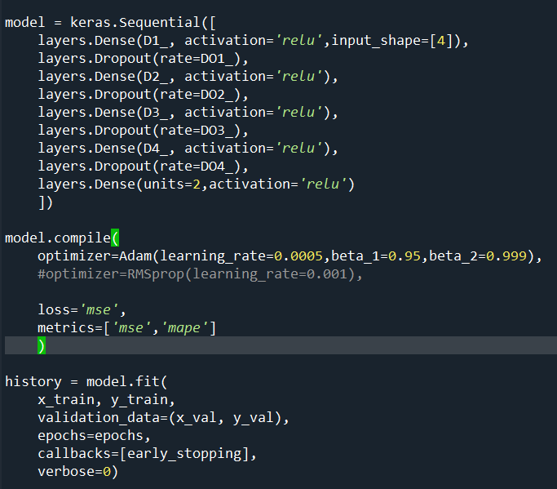
Python Keras library
Steps
Define DNN architecture
Compile DNN model
Train the model
Use the model

Slide 7
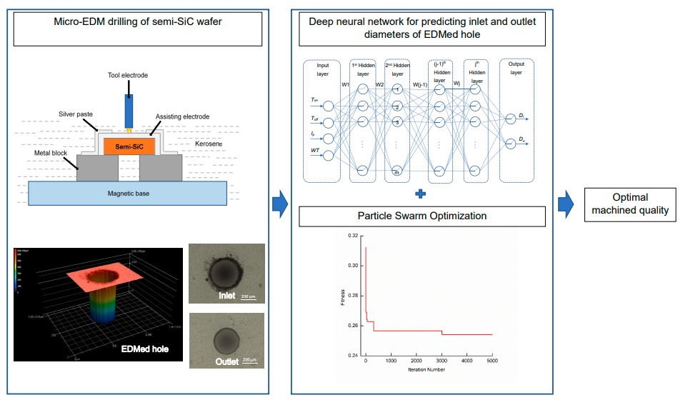
Exercise 1: regression problem
Build a DNN model: 4 inputs, 4 hidden layers, 2 outputs
Code: regression.py

Slide 8
Exercise 2: classification problem
Classify images of clothing
Input an image
DNN model
Classify result
(T-shirt/top, Trouser, Pullover, Dress,..)
Basic classification: Classify images of clothing | TensorFlow Core

Slide 9
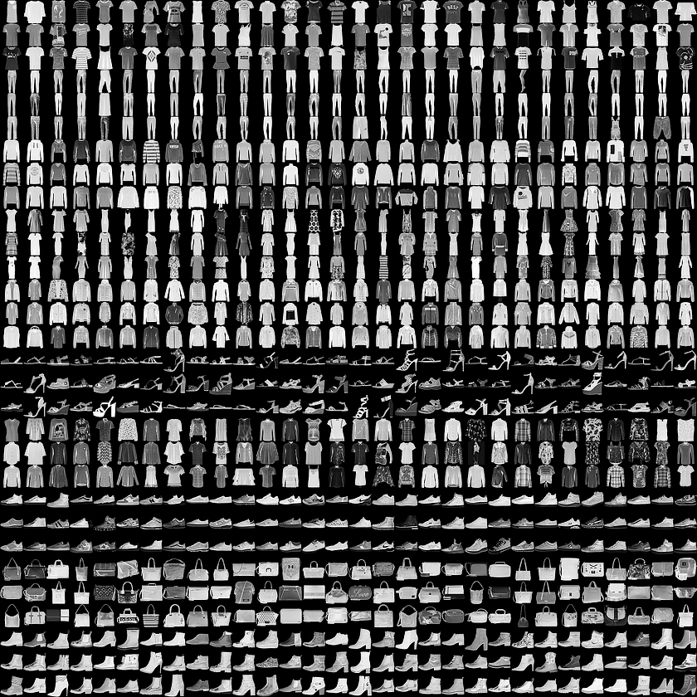
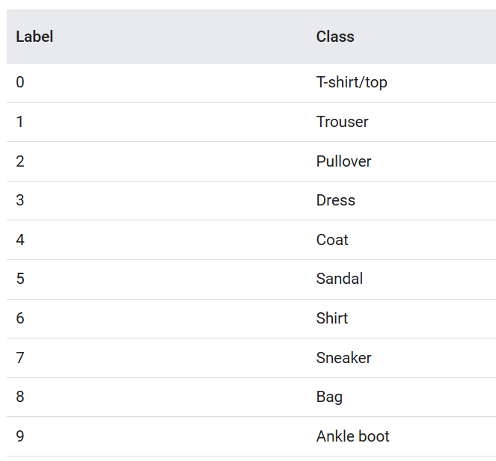
Example of dataset

Slide 10
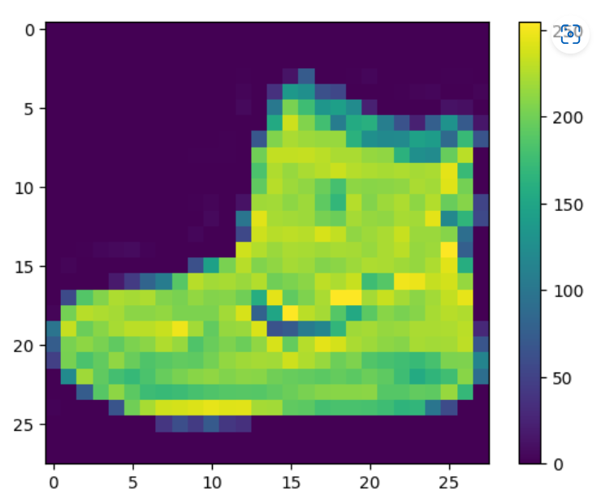
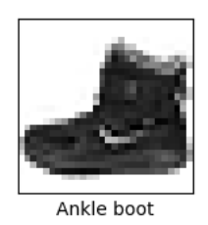
Preprocess the data
Scale these values to a range of 0 to 1 before feeding them to the neural network model. To do so, divide the values by 255.
train_images = train_images / 255.0 test_images = test_images / 255.0

Slide 11
Build the model
model = tf.keras.Sequential([ tf.keras.layers.Flatten(input_shape=(28, 28)), tf.keras.layers.Dense(128, activation='relu'), tf.keras.layers.Dense(10) ])
model.compile(optimizer='adam', loss=tf.keras.losses.SparseCategoricalCrossentropy(from_logits=True), metrics=['accuracy'])

Slide 12
Train the model
model.fit(train_images, train_labels, epochs=10)

Slide 13
Evaluate accuracy
test_loss, test_acc = model.evaluate(test_images, test_labels, verbose=2) print('\nTest accuracy:', test_acc)

Slide 14
Make predictions
predictions = probability_model.predict(test_images)
predictions[0]
np.argmax(predictions[0])

Slide 15
https://colab.research.google.com/

